Slide 1
PowerPoint Role-Play
“Staying Healthy”
May 2011

Slide 2
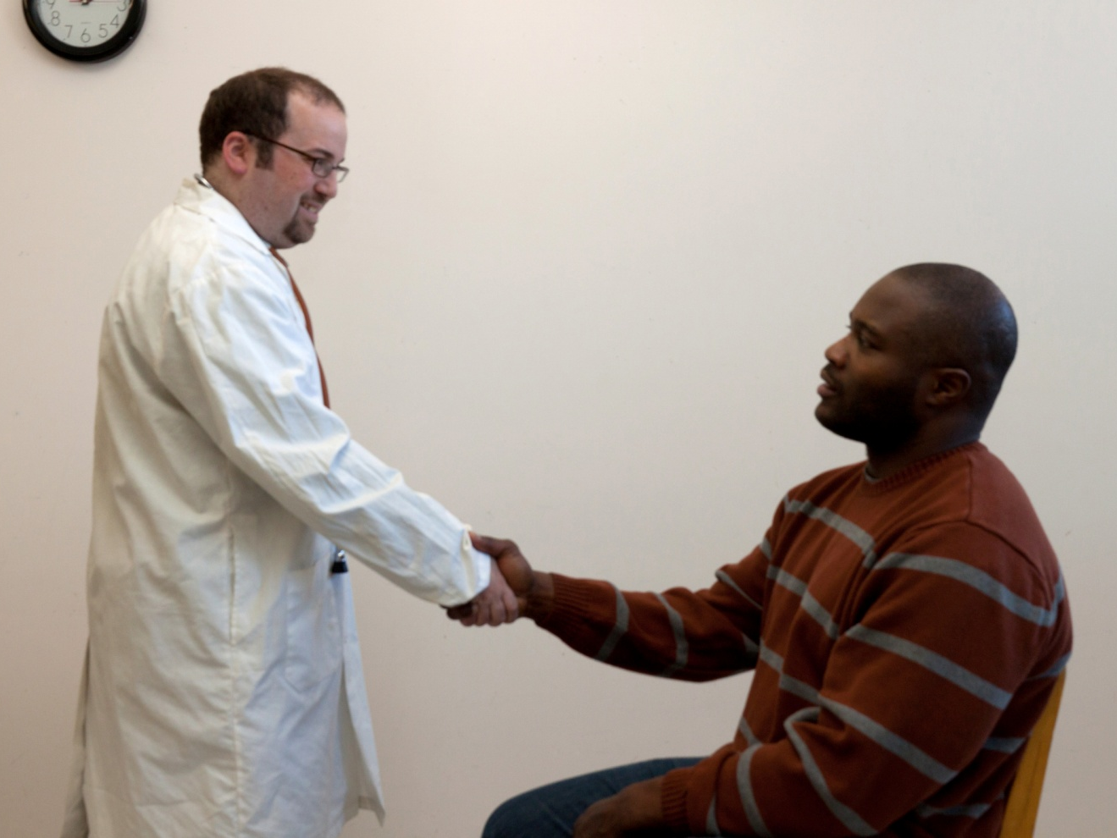

Doctor:
Hello Mr. Stewart, I am Doctor Spector. How can I help you?

Slide 3
Patient:
It’s nice to meet you Dr. Spector. I have been having problems with my wrist and hands for over 6 months and it’s getting worse.

Slide 4
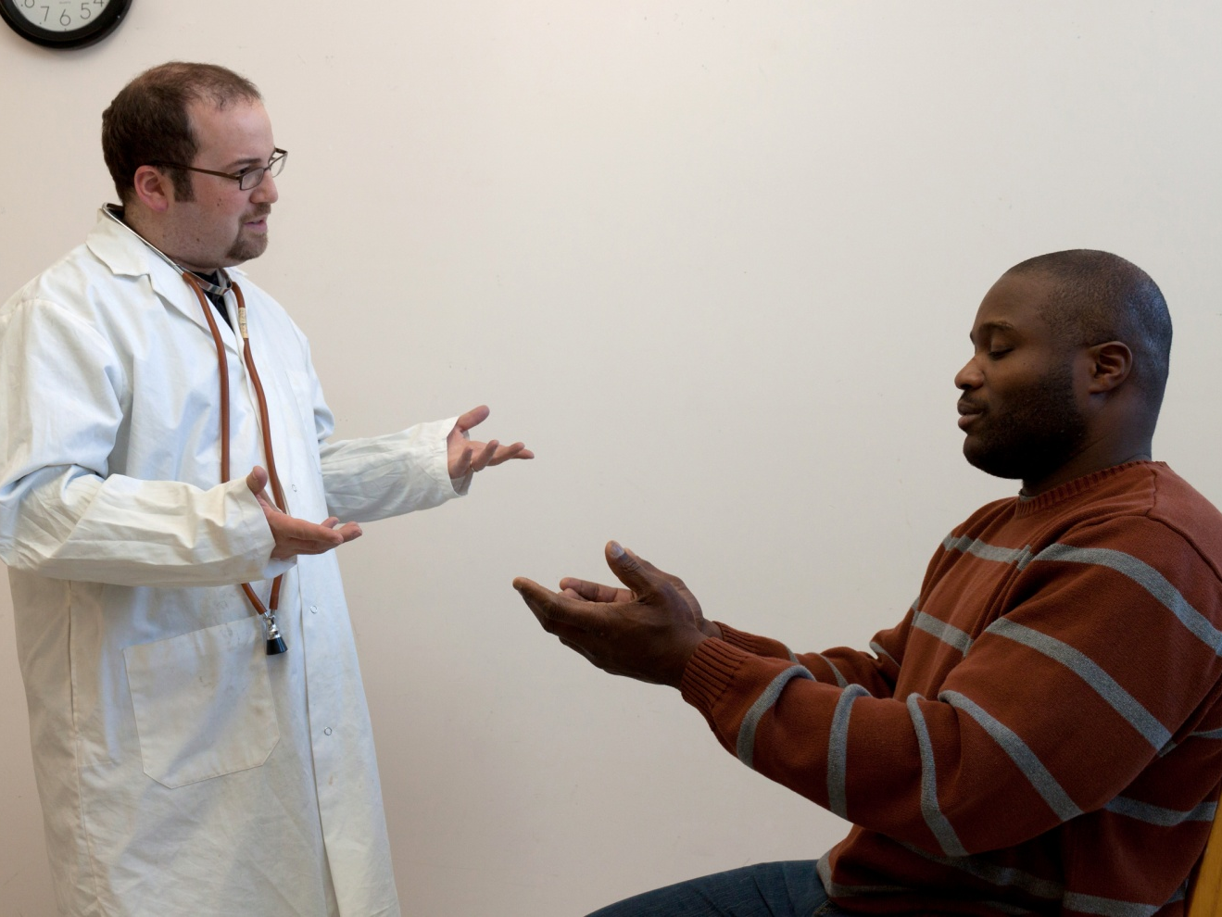
Doctor:
What kind of problems are you having?

Slide 5
Patient:
I am having problems with tingling and numbness in my fingers as well as pain in my fingers and wrist.

Slide 6
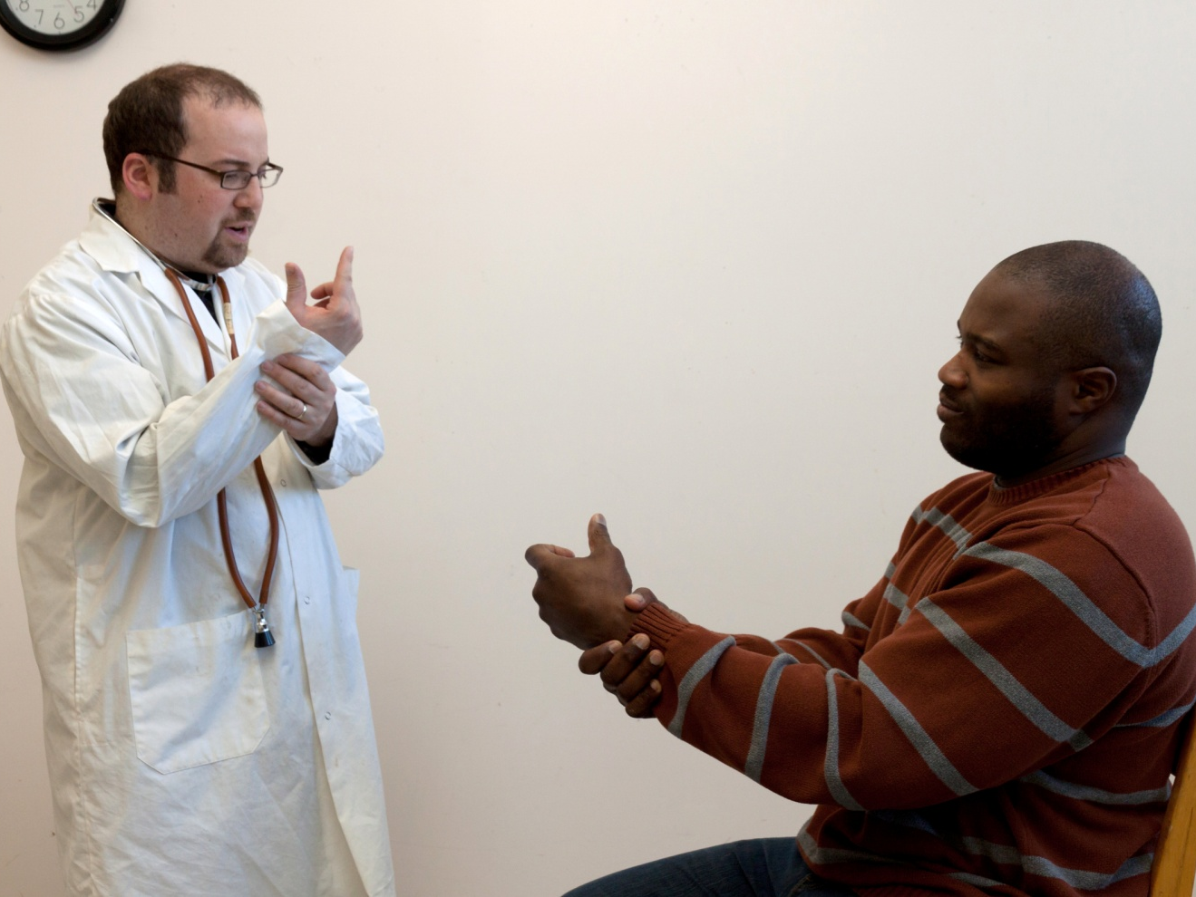
Doctor
Where is the pain located?

Slide 7
Patient
Mostly in my fingers, thumbs, and wrists, but sometimes the pain shoots up my arm to my elbow.

Slide 8
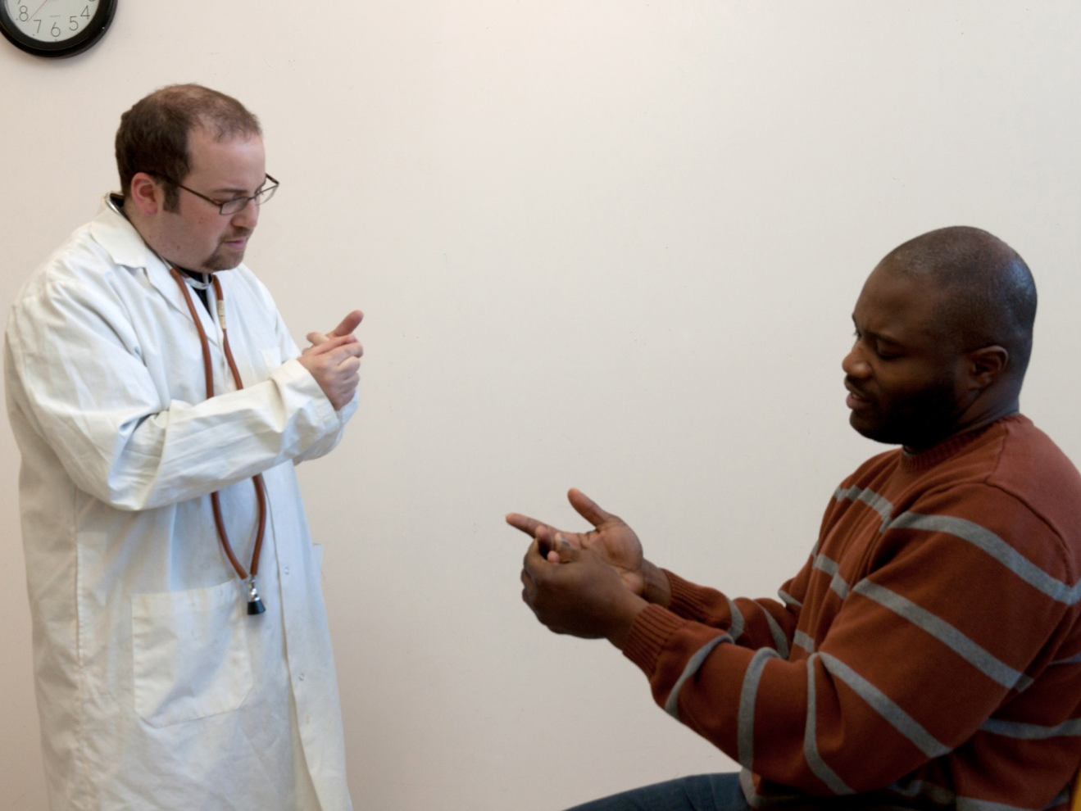
Doctor
Which fingers are affected?

Slide 9
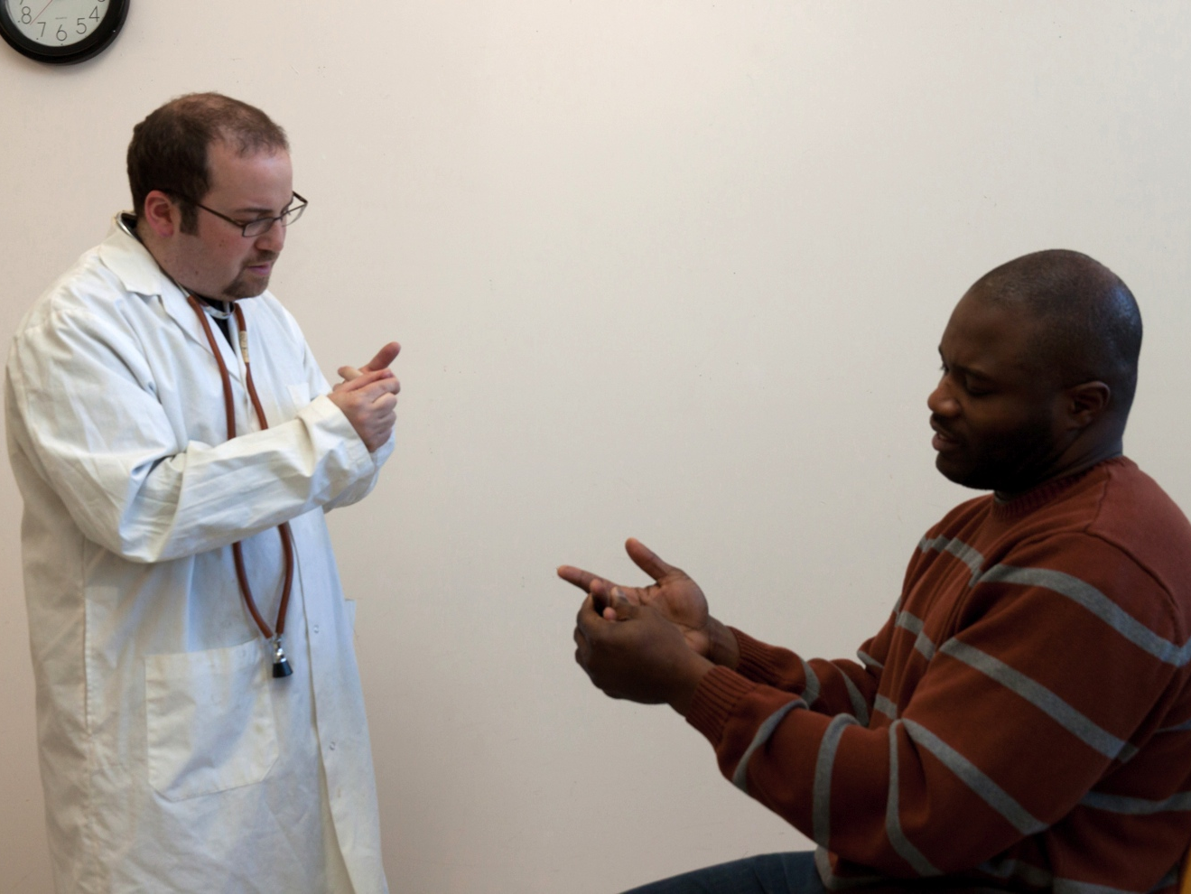
Patient
Almost all of them including my thumbs.

Slide 10
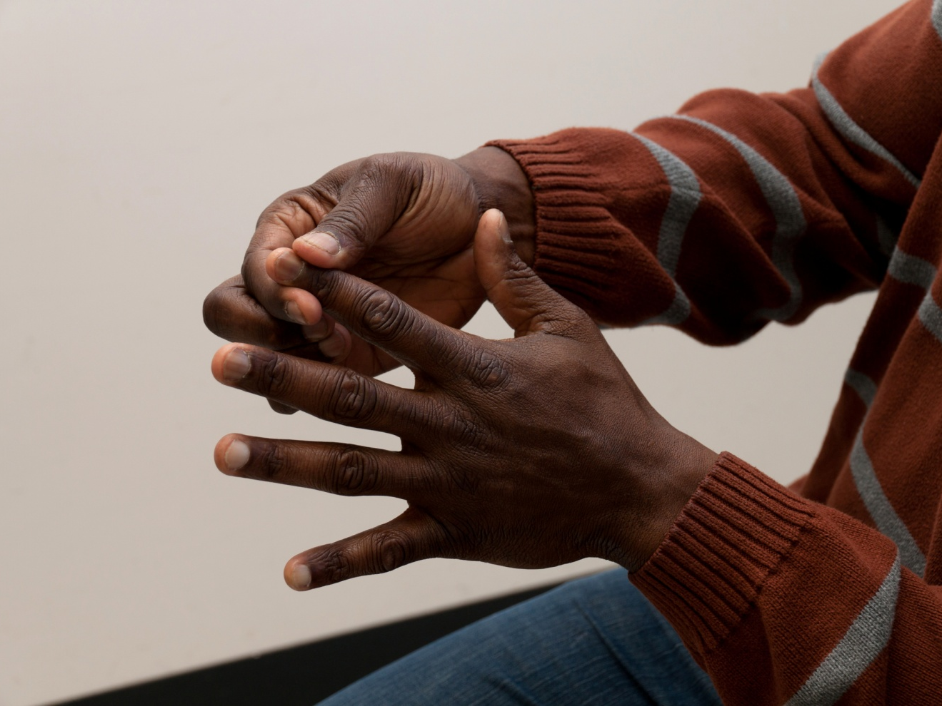
Patient
The worst pain, numbness and tingling is in my index fingers. It is especially bad when I straighten my fingers. Then there is even more pain and aching.

Slide 11
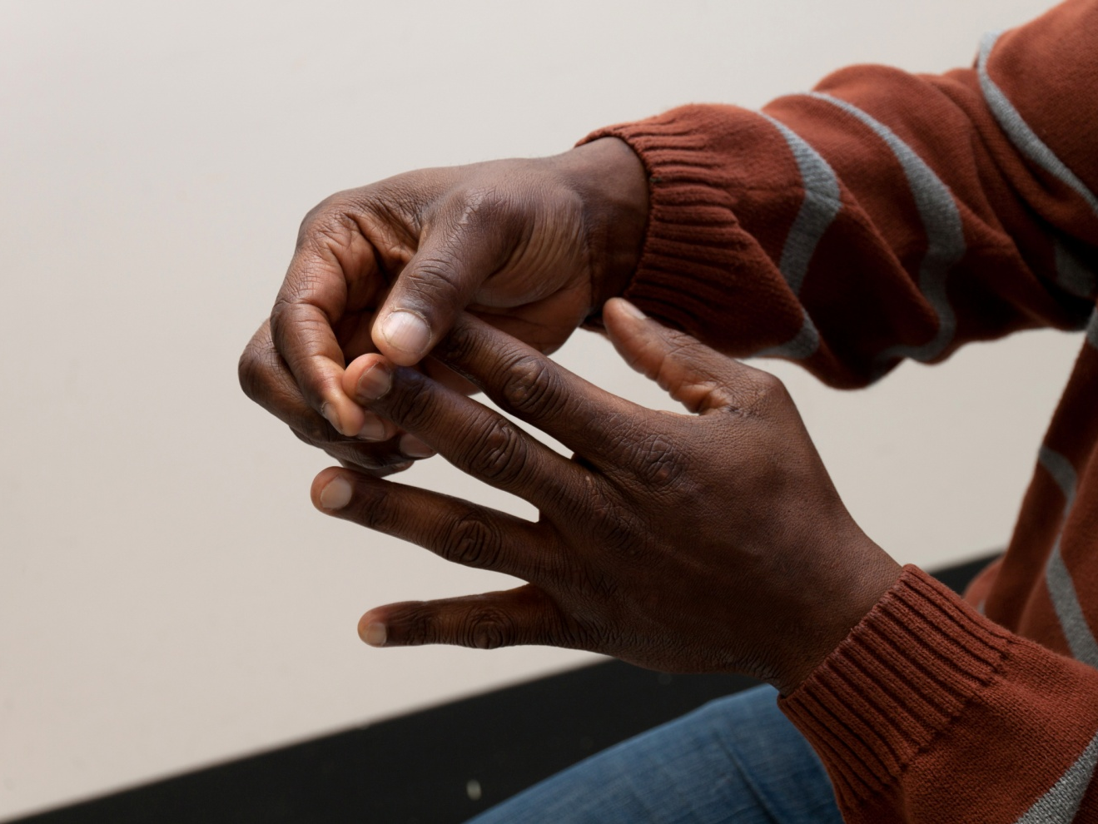
Patient
My middle finger and my ring finger are affected too.

Slide 12
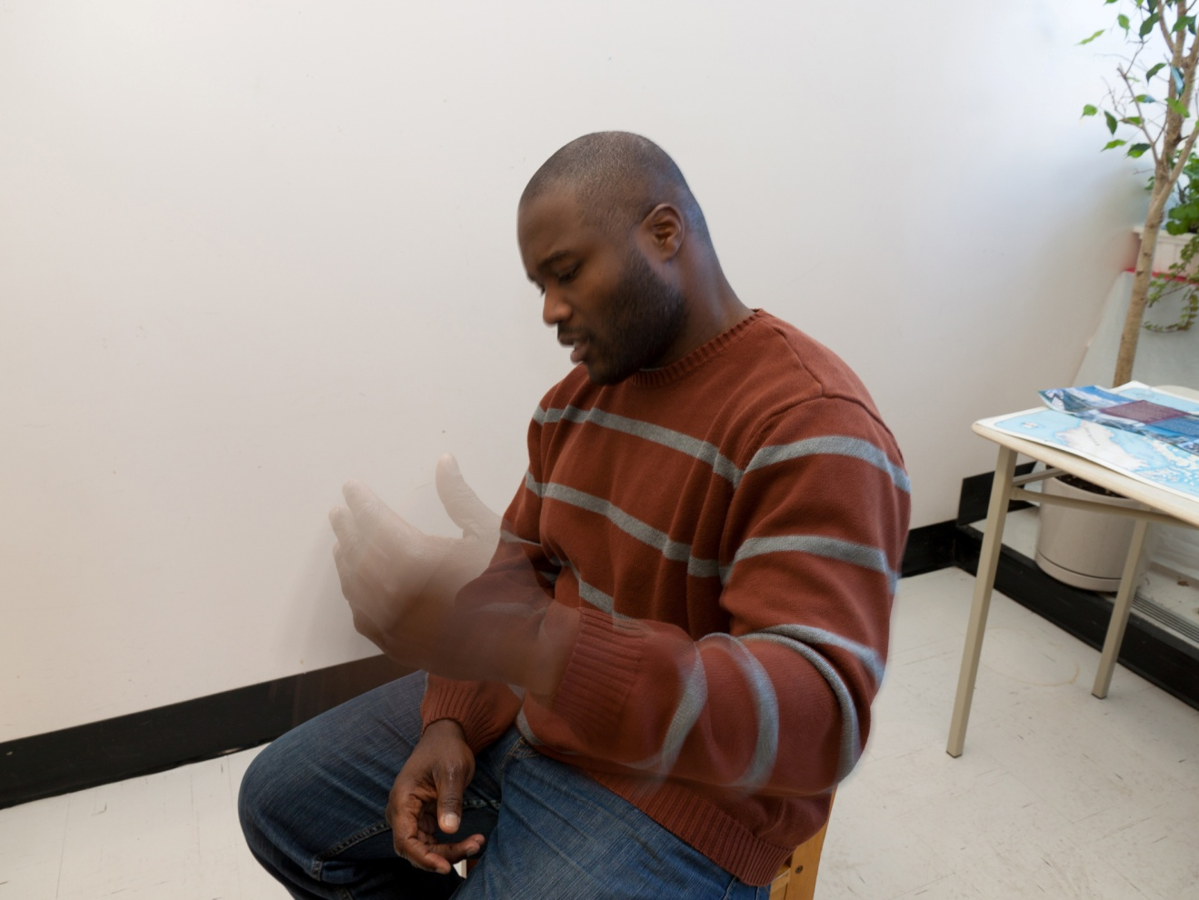
Patient
At night the pain and tingling are even worse and it wakes me up. I find if I shake my hands, it feels better.

Slide 13
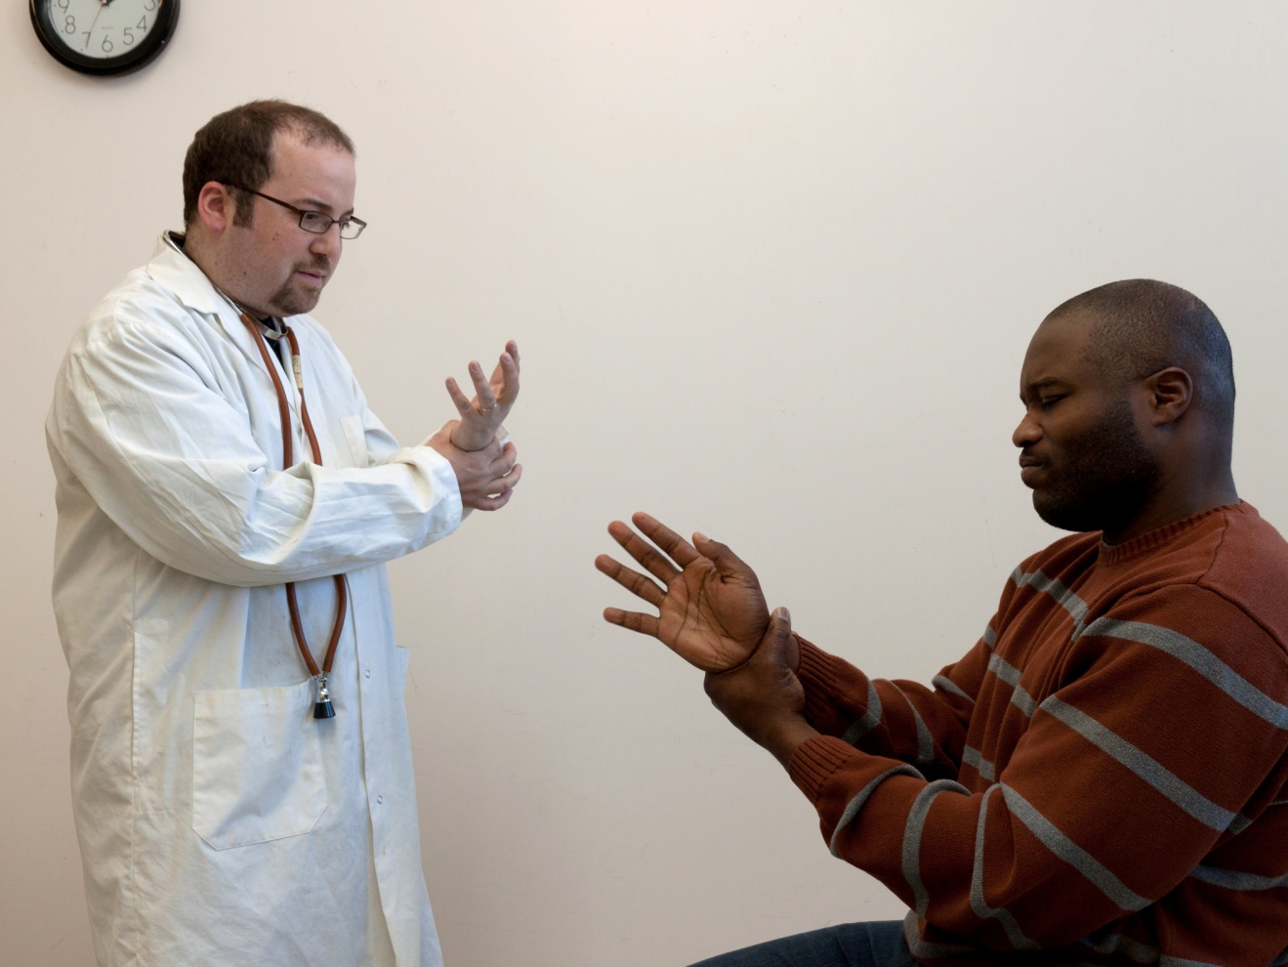
Doctor
Which wrist movements cause you pain?

Slide 14
Patient
The pain is especially bad when I bend my wrist forward.

Slide 15
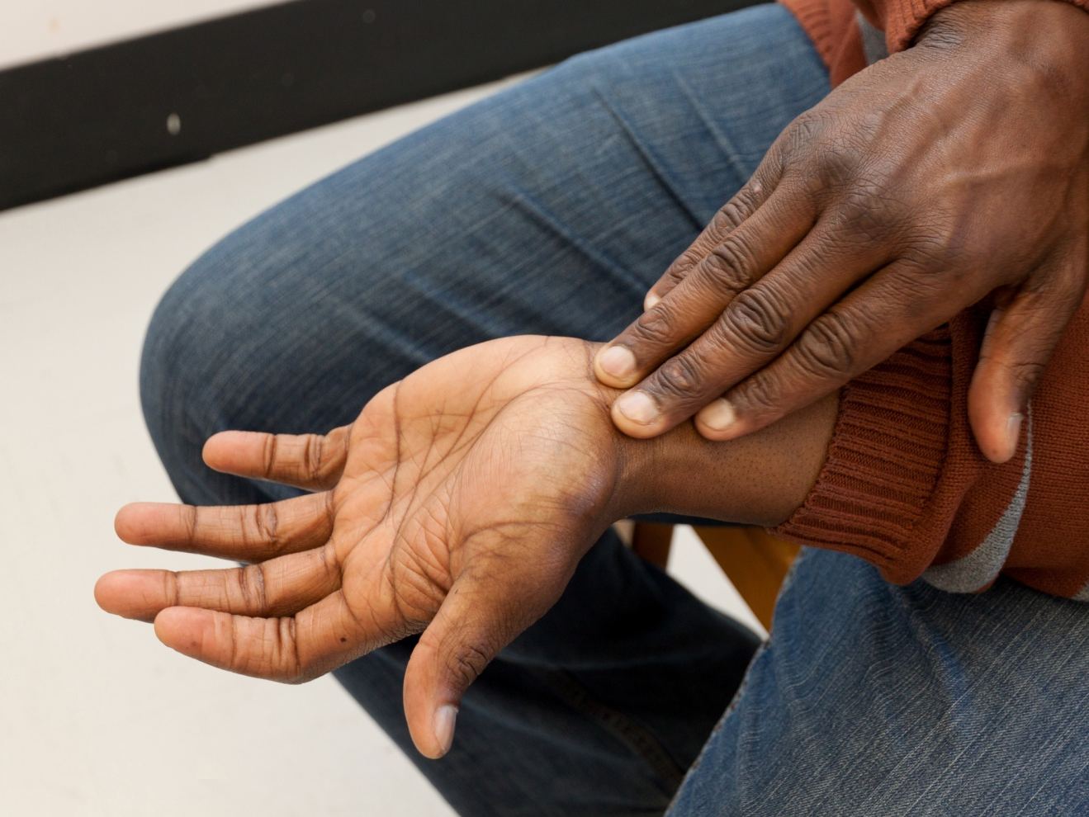
Patient
When I bend my hand forward, I feel a burning sensation in my wrist.

Slide 16
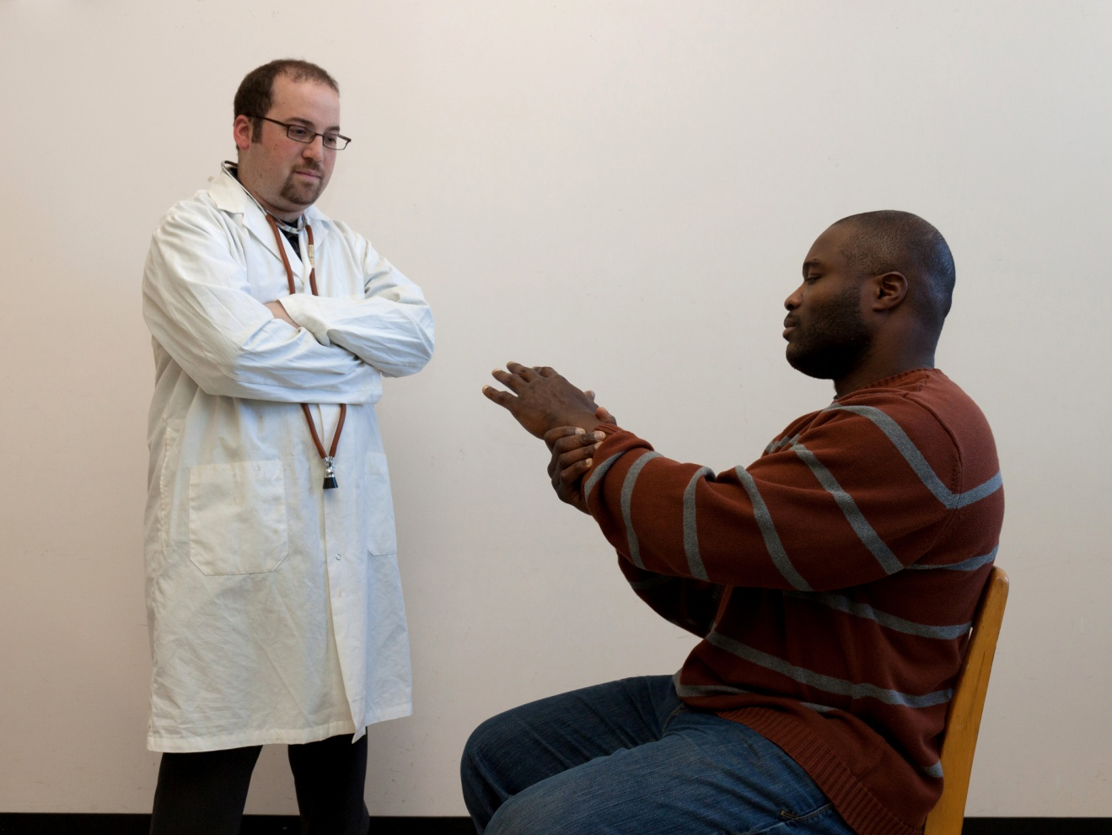
Doctor
Do you sometimes feel pain in your arm?

Slide 17
Patient
Yes, sometimes the pain shoots up my arm as far as my elbow.

Slide 18
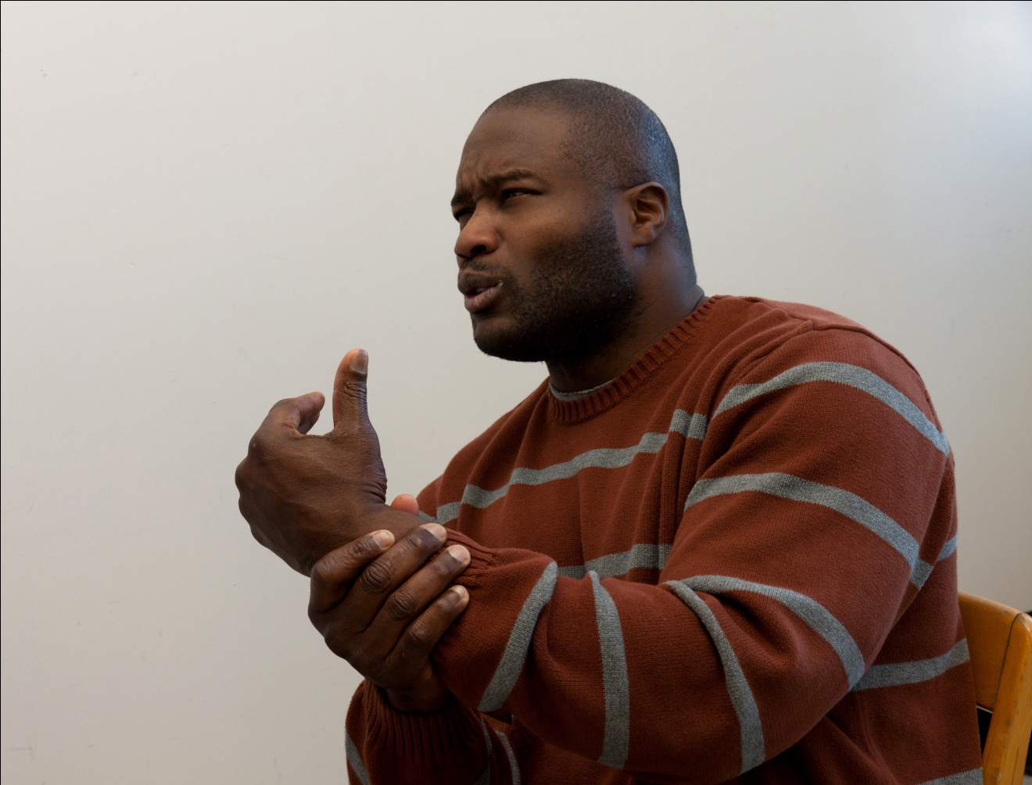
Patient
The pain in my arm is especially bad at night if I lie on my hand the wrong way.

Slide 19
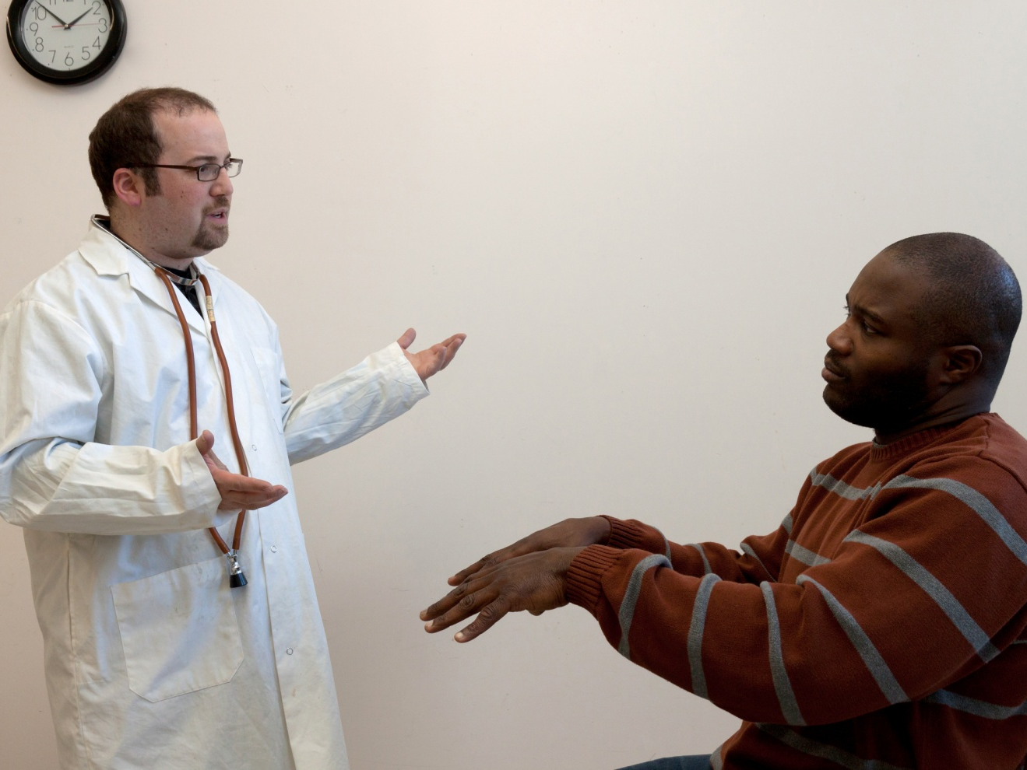
Doctor
Does this problem affect your work?

Slide 20
Patient
I work as a software engineer, so I spend all day working at a computer. I am in a lot of pain when I type and I am finding it really difficult to do my job.

Slide 21

Doctor
I am going to apply a little downward pressure to your thumb. Try to resist the pressure.

Slide 22
Patient
I find it difficult to resist the pressure.

Slide 23
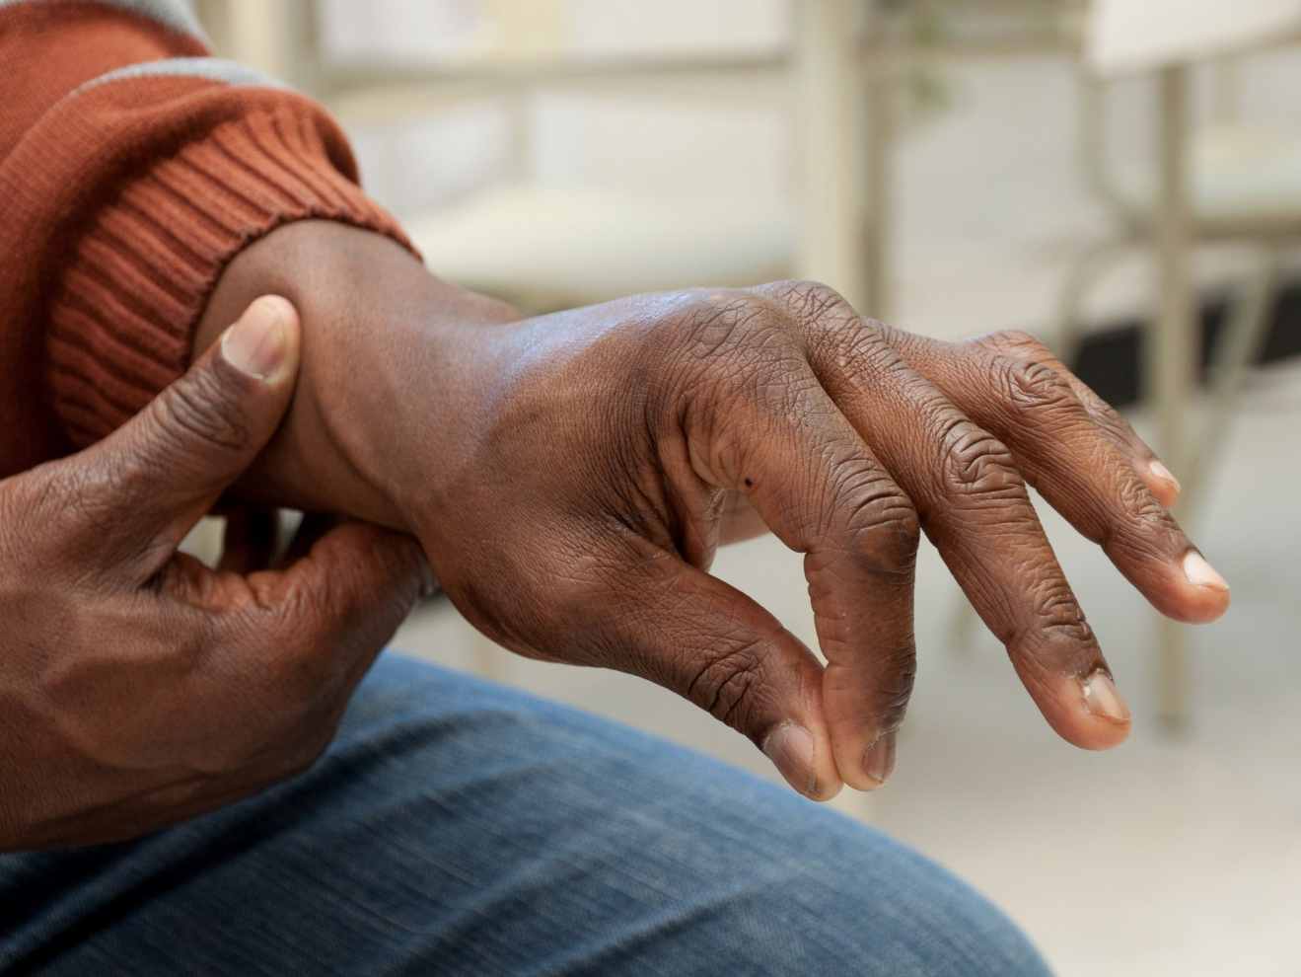
Patient
That’s another problem I’m having. I have lost strength in my hands. Sometimes when I try to pick something up, I drop it.

Slide 24

Doctor
I am checking to see whether there is any swelling in your joints. Does this hurt?

Slide 25
Patient
No, it doesn’t. My joints don’t seem to be swollen.

Slide 26
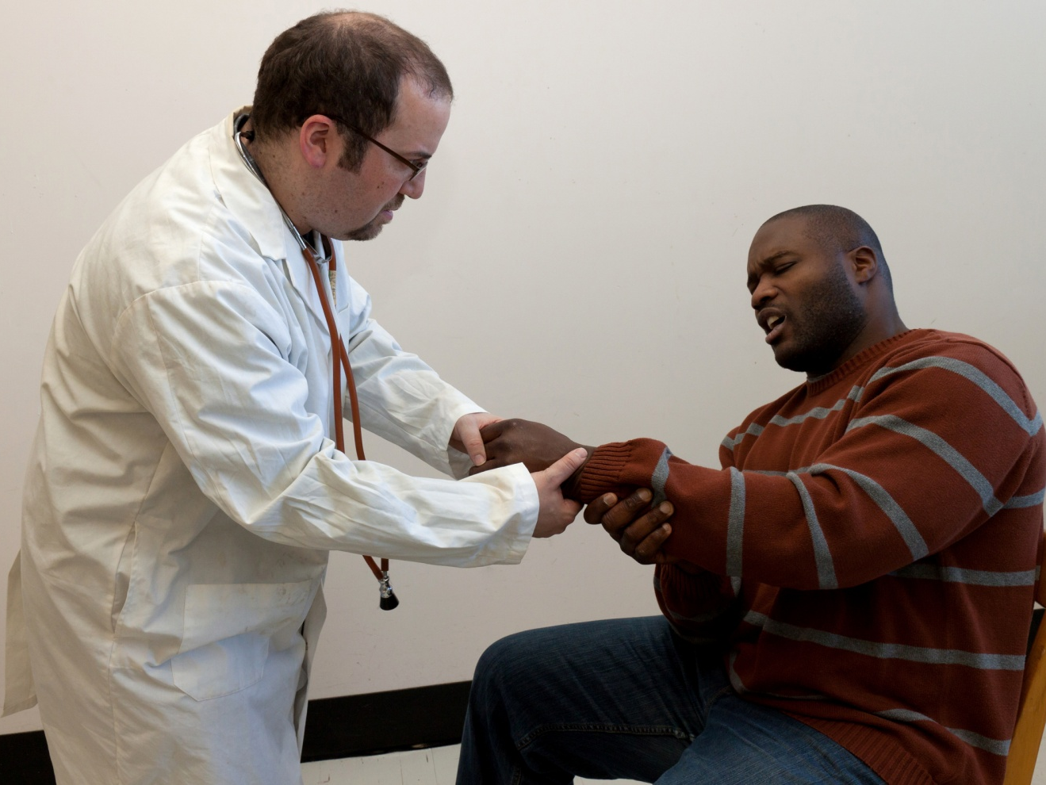
Doctor
Does it hurt when I bend your wrist now?

Slide 27
Patient
Oh, yes. That really hurts!

Slide 28
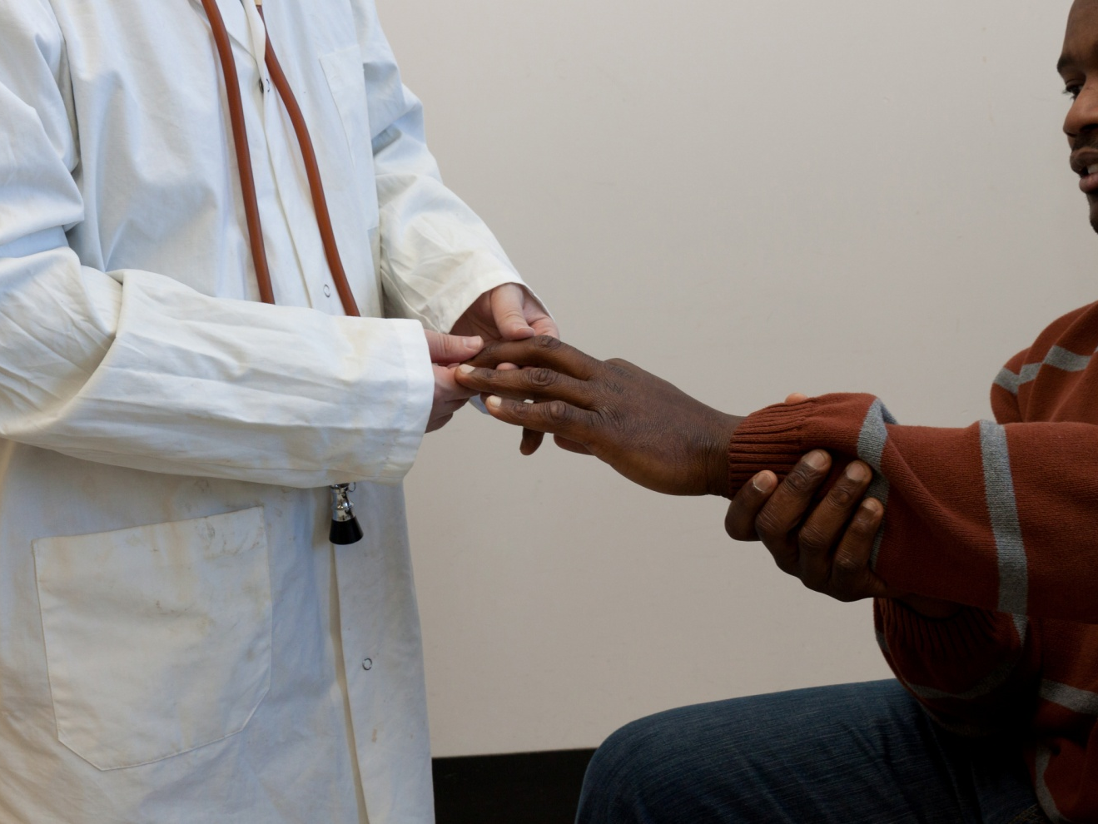
Doctor
When I apply pressure to your fingertips, do you feel more tingling?

Slide 29
Patient
No, pressure on my fingertips doesn’t change the amount of numbness and tingling I feel.

Slide 30
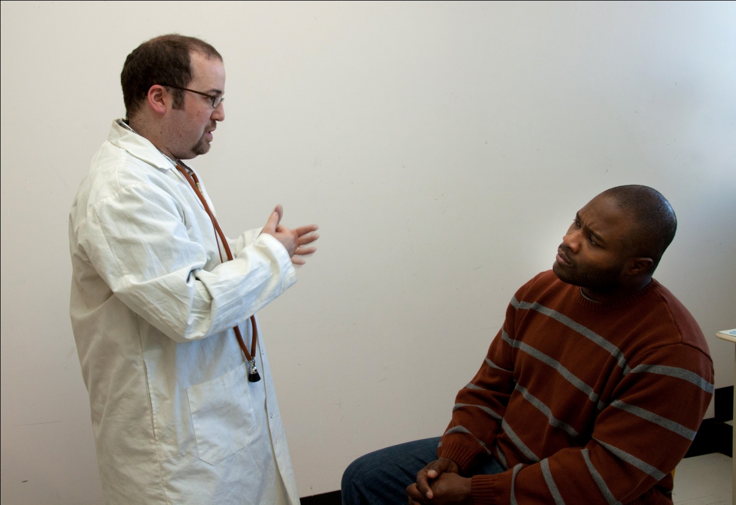
Doctor
Well Mr. Stewart, it will looks like your have classic case of carpal tunnel syndrome, but I want you to have an EMG to confirm the diagnosis.

Slide 31
Patient
What is an EMG?

Slide 32
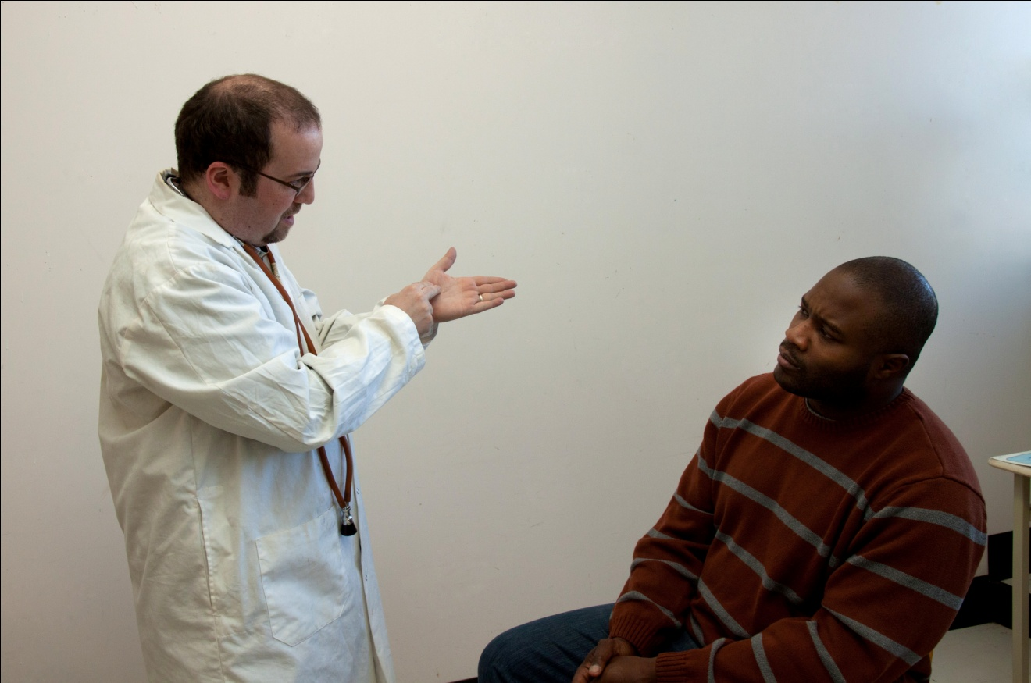
Doctor
An EMG or electromyogram uses electrodes attached to your skin to measure the speed of the electrical impulses as they travel down the nerve. Don’t worry, it’s relatively painless, but it may sting a little.

Slide 33
Patient
I’ve heard of carpal tunnel syndrome. What is it caused by and how can you treat it?

Slide 34
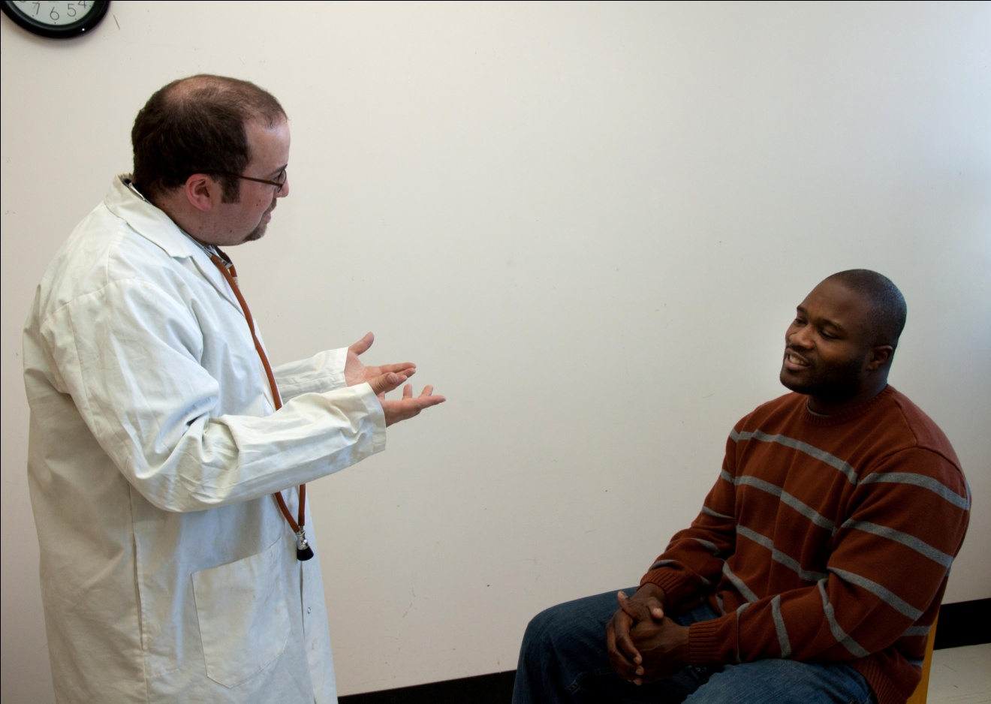
Doctor
Carpal tunnel syndrome is caused by irritation of the median nerve in the wrist. Repetitive activities, such as typing all day can cause this irritation. The treatment depends on the severity of the symptoms.

Slide 35
Patient
What is the best treatment in my case?

Slide 36
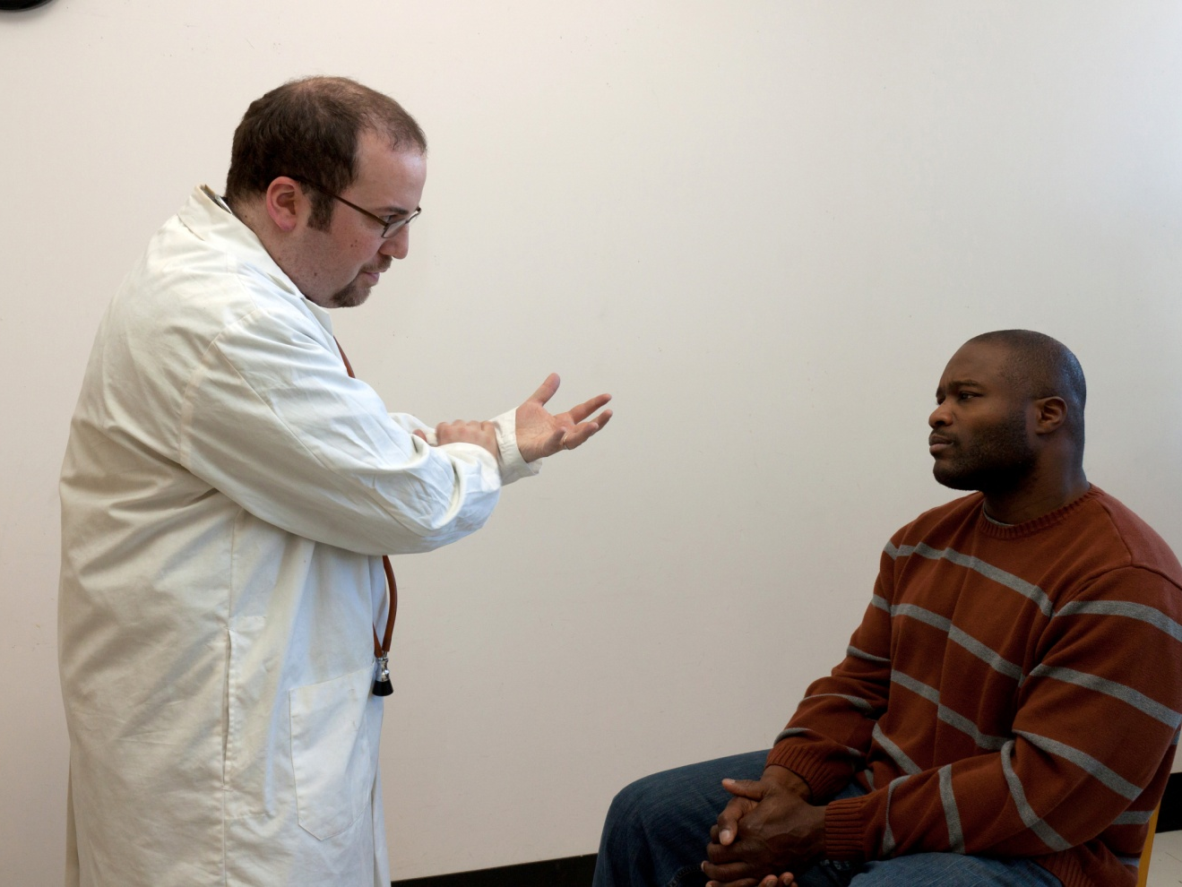
Doctor
I am going to prescribe custom made splints that you wear at night and even in the daytime if it’s possible. It supports your wrists so the nerve doesn’t get pinched. You will find that it will ease the tingling, and numbness, and pain. It is important to rest your hands as much as possible too.

Slide 37
Patient
That sounds good. What happens if the splints don’t work?

Slide 38
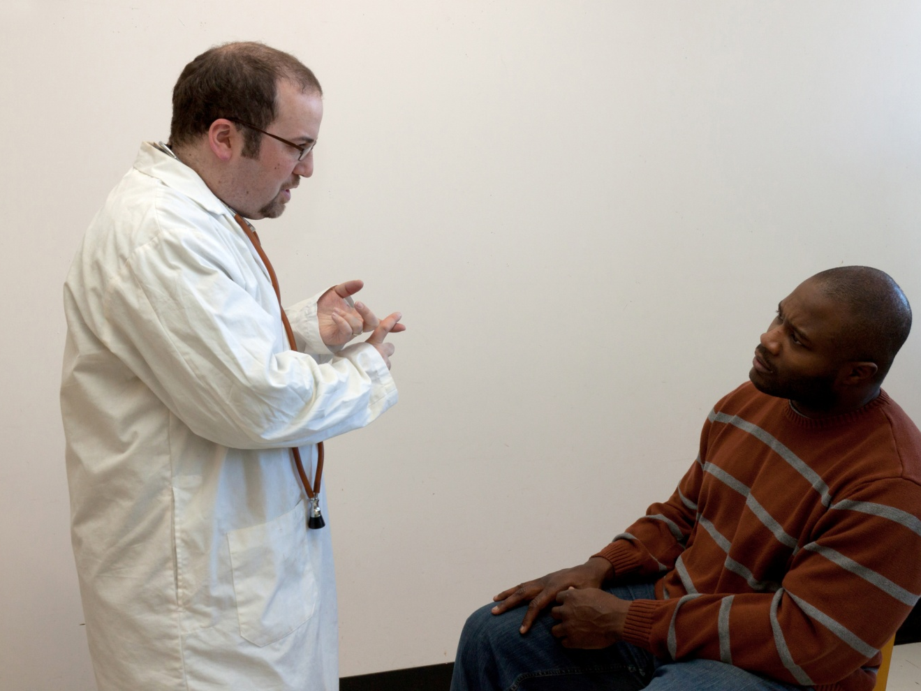
Doctor
An injection of corticosteroids can being rapid relief to many patients

Slide 39
Patient
And if that doesn’t work?

Slide 40
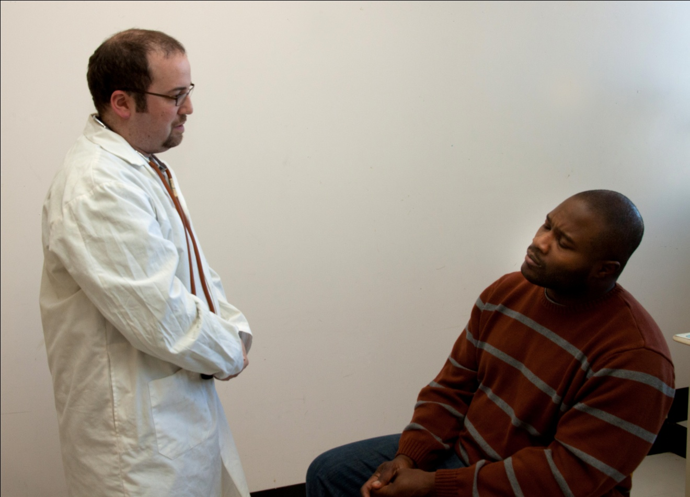
Doctor
Most patients improve with the splint and medication. Occasionally, in serious cases, a surgical treatment is considered. It is called a “carpal tunnel release”, but I believe that your problem can be resolved without surgery.

Slide 41
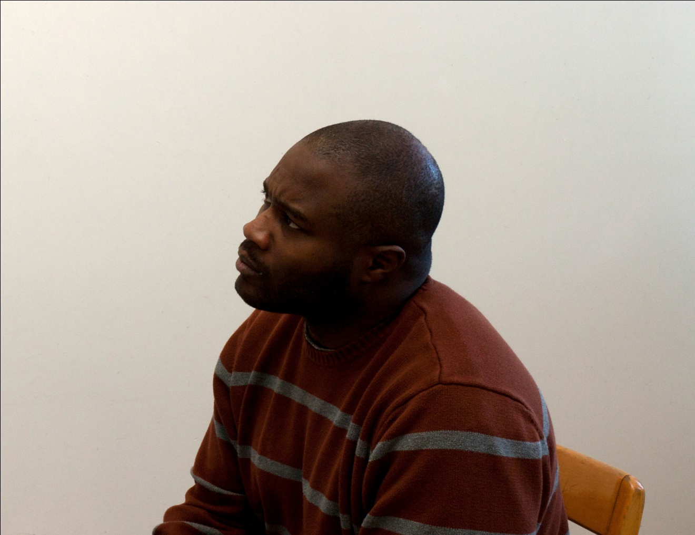
Patient
When can I begin treatment?

Slide 42
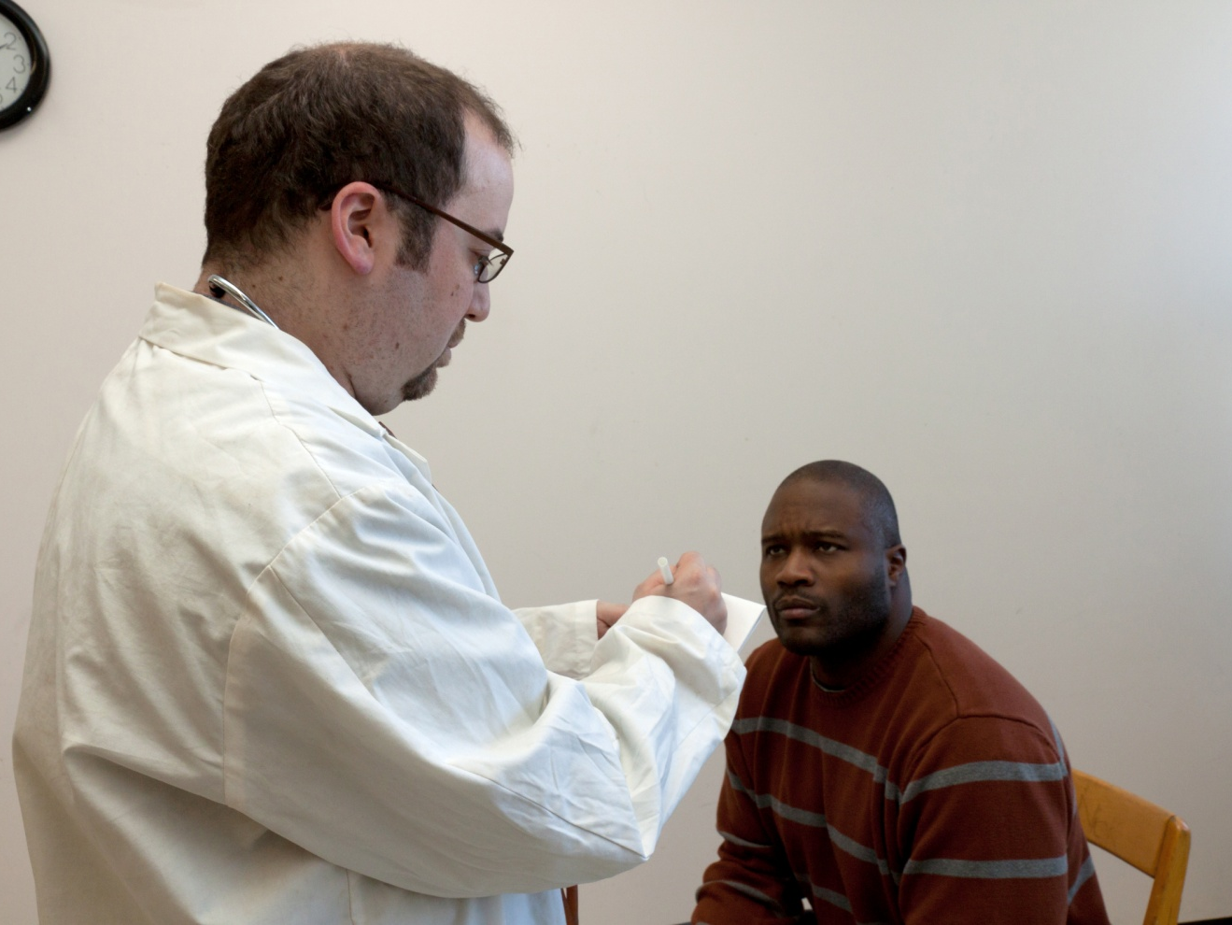
Doctor
Don’t worry. I’m writing a prescription for the splints now. However, you can get them even before your take EMG test.

Slide 43
Patient
That’s great!

Slide 44
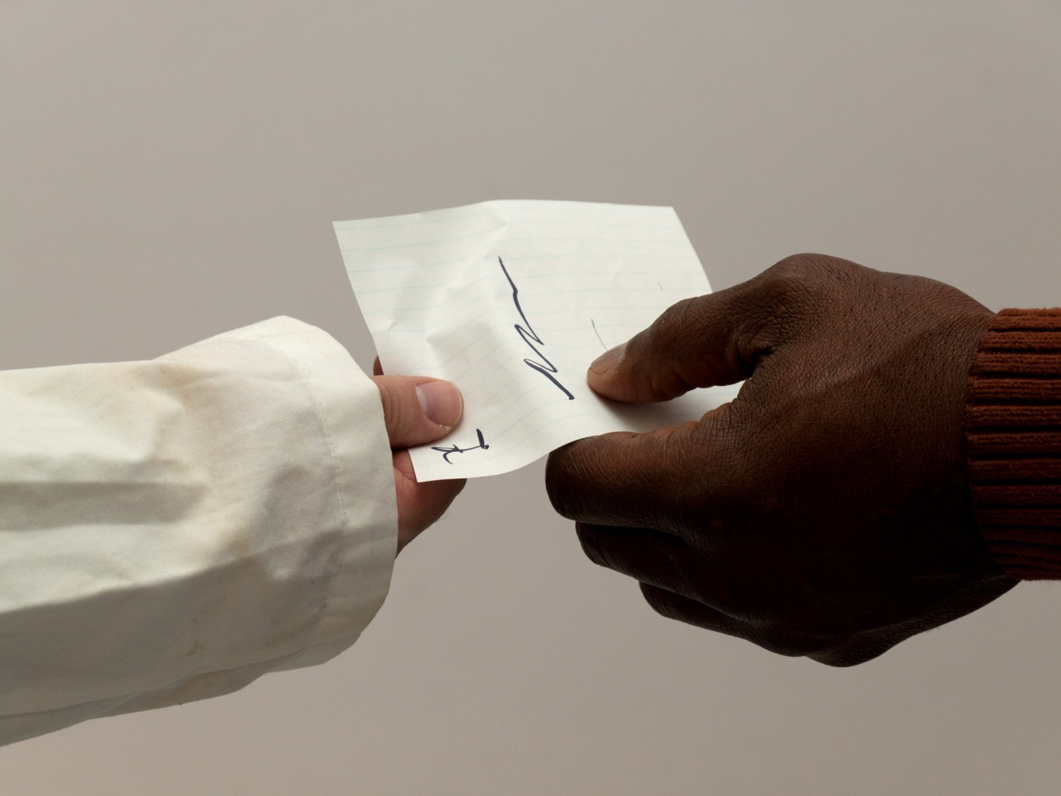
Doctor
Here it is and my secretary will give you the names of suppliers who can custom fit your splints.

Slide 45
Patient
Thank you!

Slide 46
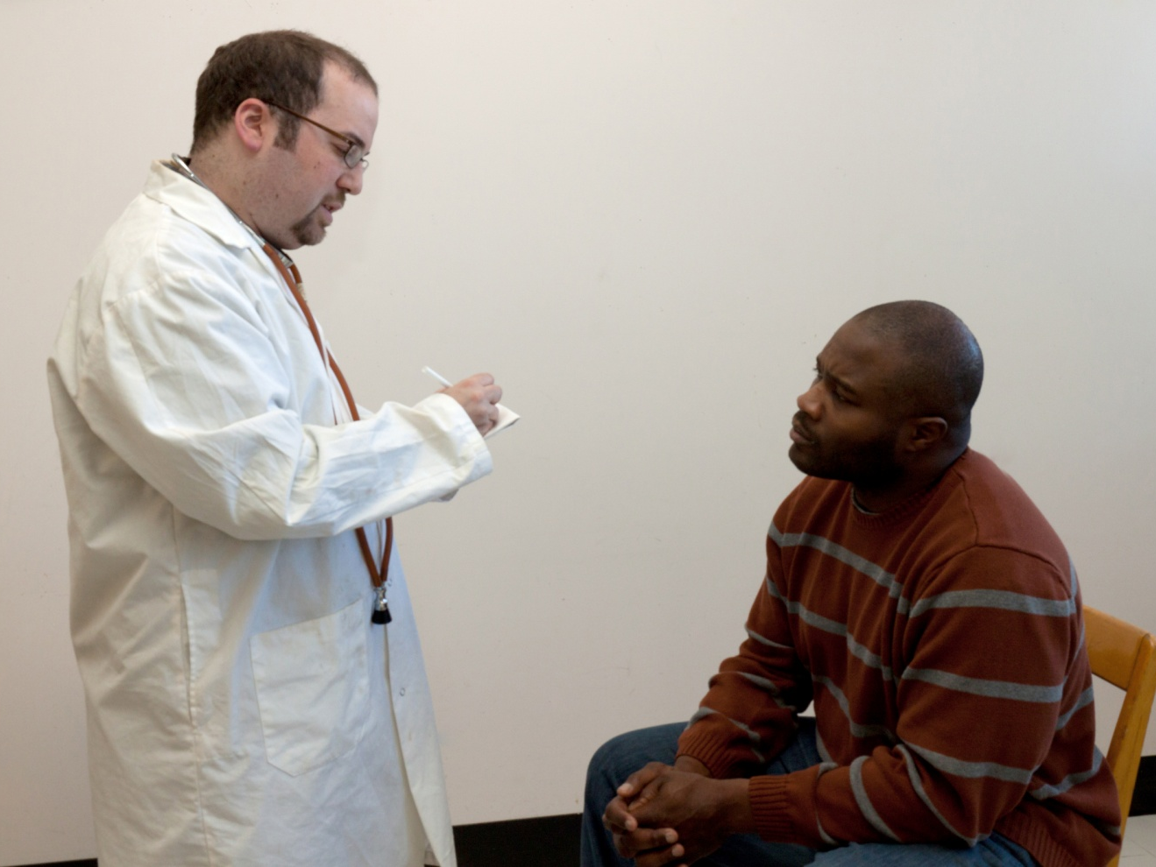
Doctor
Here is the referral for the EMG. Come back to see me after you have had the tests. My secretary can book the test and a follow-up visit for you today.

Slide 47
Patient
That would be really helpful.

Slide 48
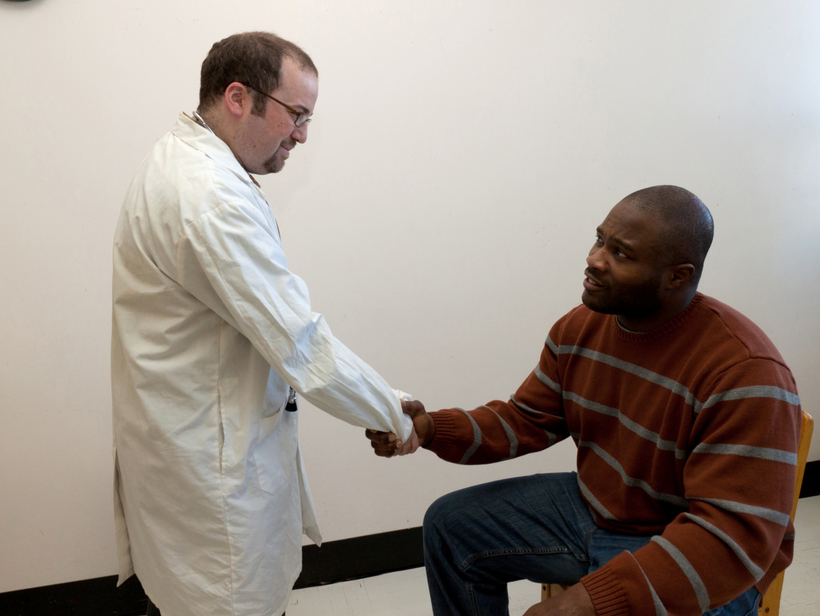
Doctor
Good-bye Mr. Stewart. I will see you again in about two weeks. Remember to rest your hands as much as possible.

Slide 49
Patient
Thank you doctor.

Slide 50
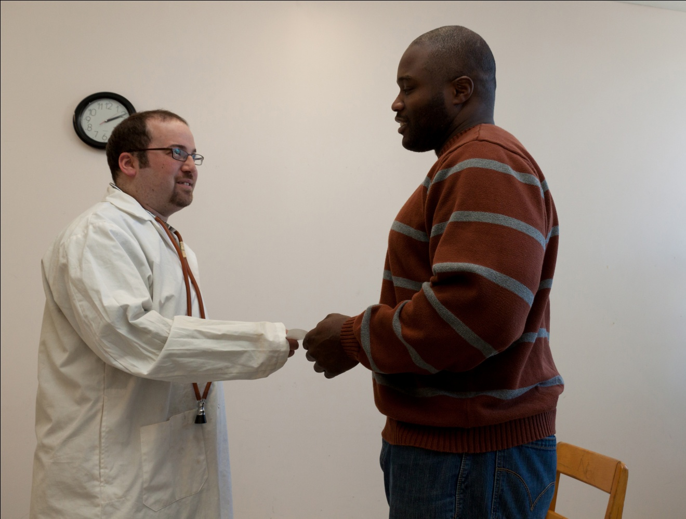
Doctor
Give this paper to my secretary to book the EMG. Don’t hesitate to call if you condition worsens.

Slide 51
Patient
Thank you, Dr. Spector. I really appreciate your help.

Slide 52
A project by Ann Fairhurst-Lozyk
James-Lyng Adult Ed.
Special thanks to:
Shawn Daniels, James-Lyng Adult Ed.
Avi Spector, RECIT FGA (aspector@rsb.qc.ca)

